Slide 1
RA, EEq, Asking, Answering, and Assessing Hypothesis
Nicolas Vuille-dit-Bille
11.05.2020
Reference:
https://www.coursera.org/learn/spatial-analysis-and-data-handling-using-arcgispro/resources/SgvlP
https://learn.arcgis.com/en/projects/calculate-environmental-equity-for-public-policy/
https://www.coursera.org/learn/spatial-analysis-and-data-handling-using-arcgispro/resources/EVyLK
https://www.coursera.org/learn/spatial-analysis-and-data-handling-using-arcgispro/resources/dt3jC

Slide 2
Outlining process
COVID-19 risk Assessment model for Hong Kong
Environmental Equity lab showing all three admin boundaries
Exploring Attributes using Enrich to visualize restaurant distribution in California according to other information
Moran’s I tool in html format
Median Household Income data from the Environmental Equity lab

Slide 3
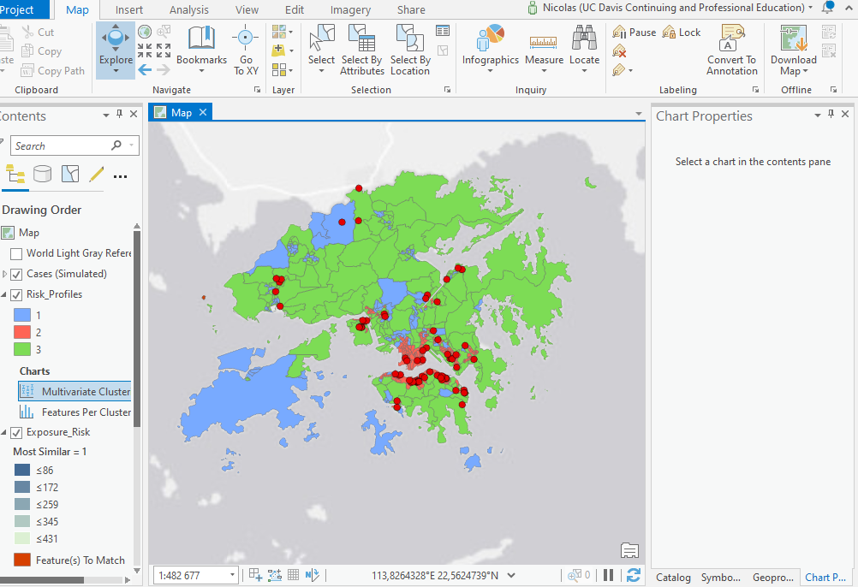
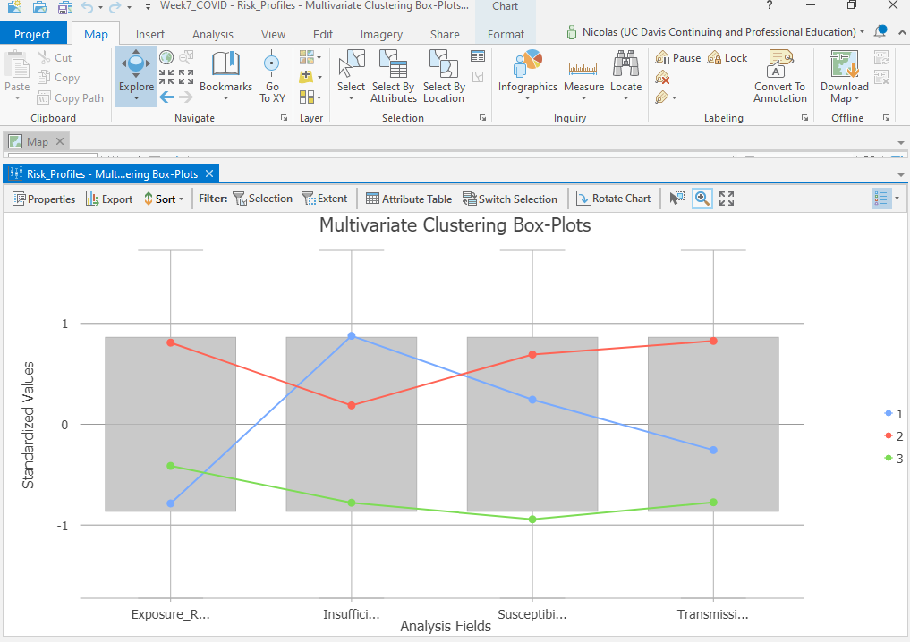
1) COVID-19 risk Assessment model for Hong Kong
Final output map
Box plot
Profile risks:
1: Minimizing interaction and plans organization for quarantine centers and healthcare training (blue)
2: Minimizing interaction (red)
3: low profile risk (green)

Slide 4
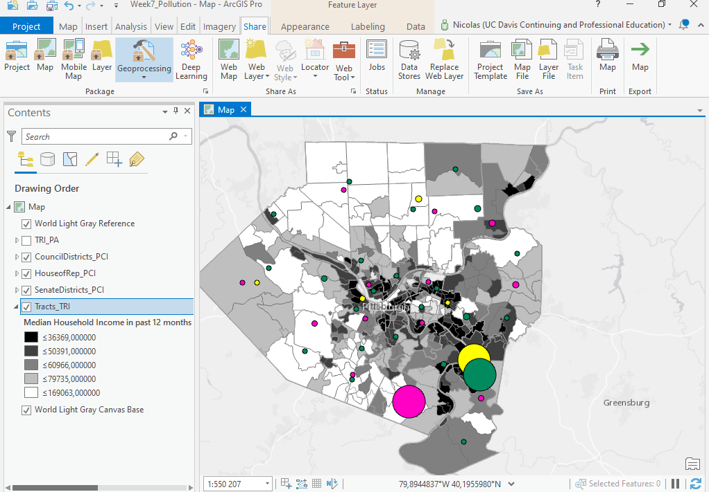
2) Environmental pollution equity lab showing all three admin boundaries
Black to white legend according to median income in the census tract
Per capita impacts of total chemicals released on site are showed with graduated symbols
Circle symbol colors indicate districts:
- Senate(yellow)
- House of Representatives (green)
- County city council (pink)

Slide 5
2) Environmental Equity web app
Link:
https://ucd-cpe.maps.arcgis.com/apps/View/index.html?appid=5186de76dc3c43ccbb079318a3cfb02d

Slide 6
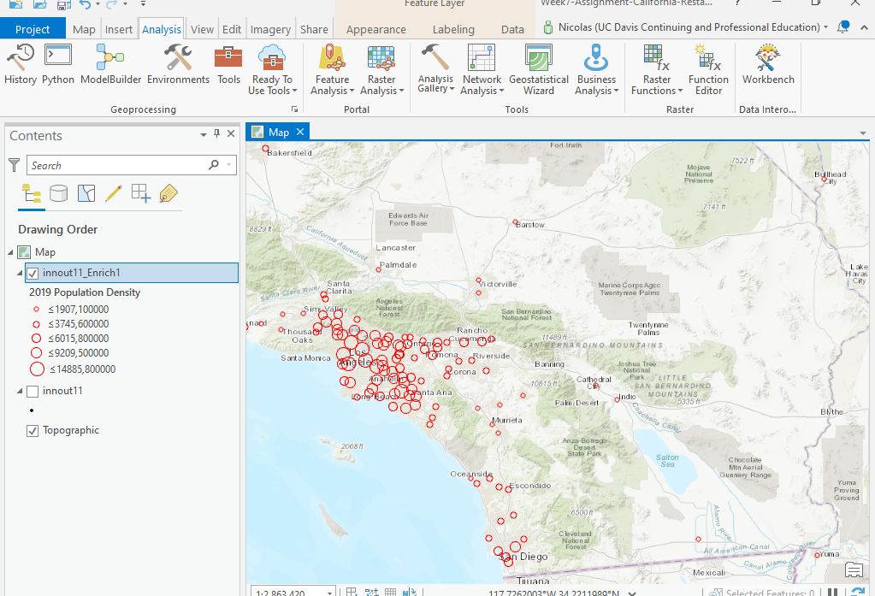
3) Exploring Attributes using Enrich to visualize restaurant distribution in California according to total population
Red circle represents restaurant location in California
Size of circle is increasing with population density in 2019
Agglomeration of restaurant location seem to be linked with population density

Slide 7
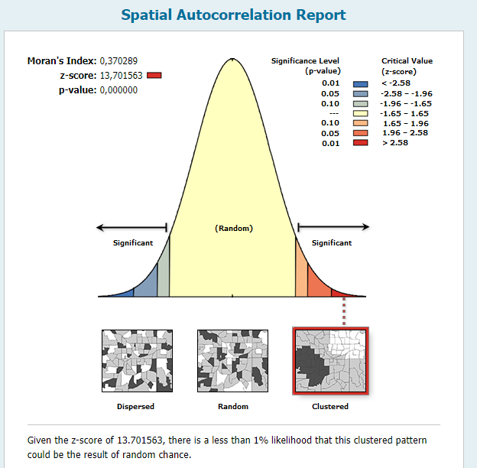
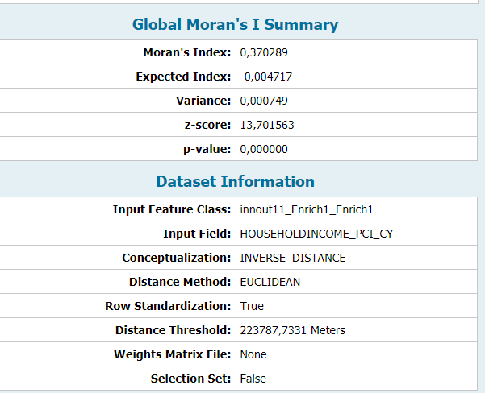
Moran’s I tool of income per capita at restaurant location in California
H0: The per capita incomes at restaurant location are a result of Complete Spatial Randomness (CSR)
For this variable, the null hypothesis is significantly rejected (Z-score>2.58) and a positive spatial correlation (0.37) is shown

Slide 8
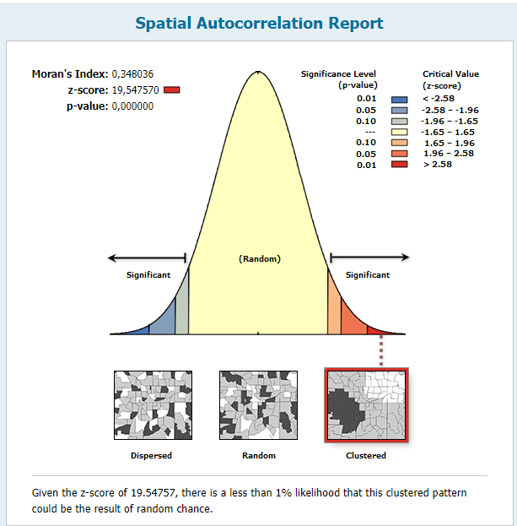
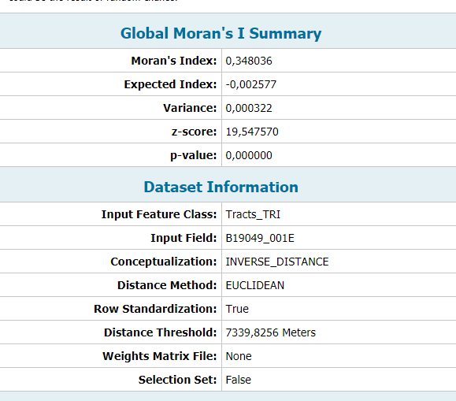
Moran’s I tool of median household income data from the Environmental Equity lab
H0: Median Household Incomes are a result of Complete Spatial Randomness (CSR)
For this variable, the null hypothesis is significantly rejected (Z-score>2.58) and a positive spatial correlation (0.34) is shown. The correlation is however relatively low (<0.5).

